Slide 1
Ashutosh J.
Lead Vocalist & Guitarist
IT Support Specialist
Rocofit
By team 32_bits

Slide 2

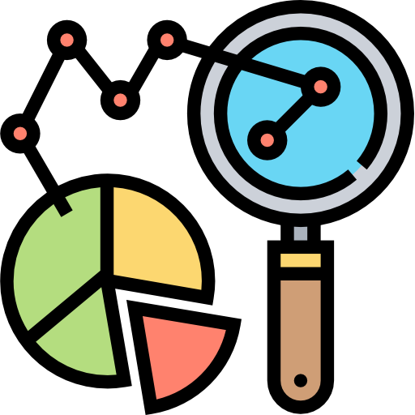
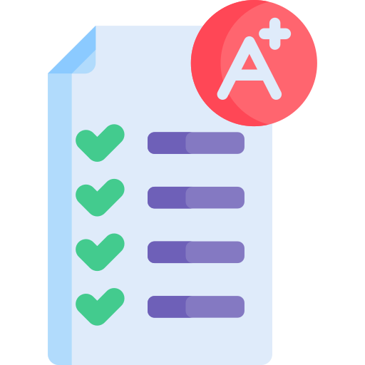
Problems that we solve
Gives recomendation on healthplans anda lso rates hospitals and doctors
Runs realtime analytics on Real time health stats taken from fitness devices and alert users
Calculates a
Health score for users based on multiple facters using Machine learning

Slide 3

How healthcare recomendation works
Runs realtime analytics on Real time health stats taken from fitness devices and alert users
We analyzed the data provided and trained a model to suggest the best healtcare
We also suggest Probable amount required for treatment and also the probable amount the patient have to pay as well as the cost of medication all based on the data provided for the competiton.We scrapped through all the documents and got the results.
Finally we also do a check on the given estimate of the healthcare so that we can track if hospitals are charging more than normal,this will be used later for rating a hospital.

Slide 4

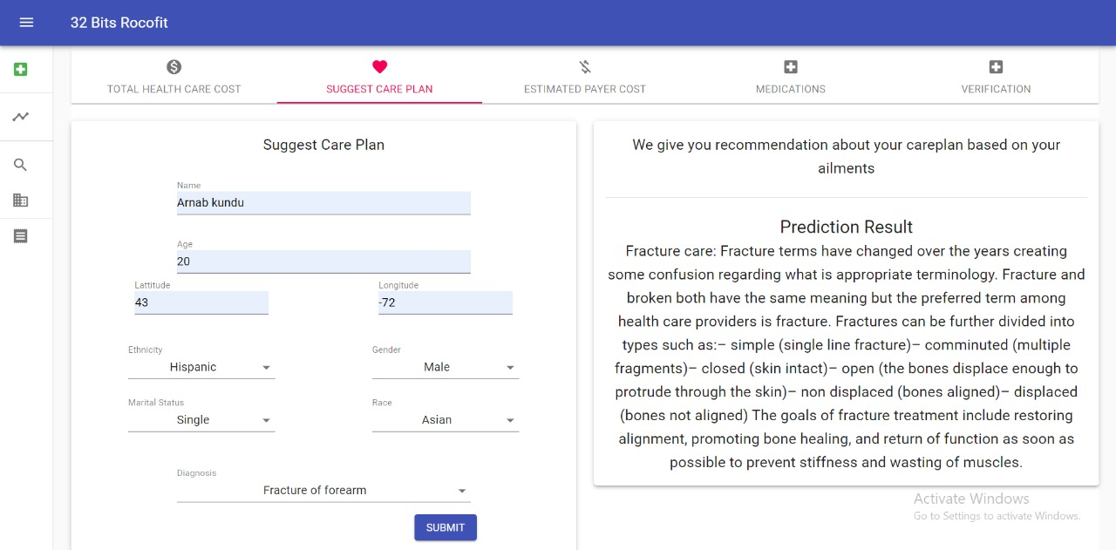
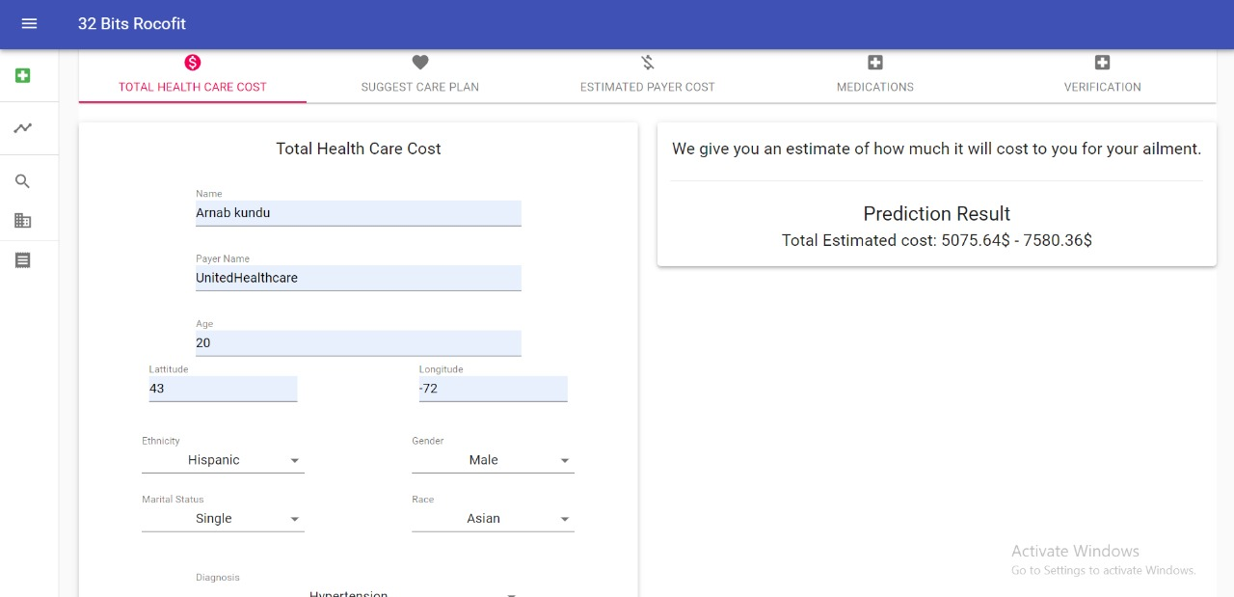

Slide 5
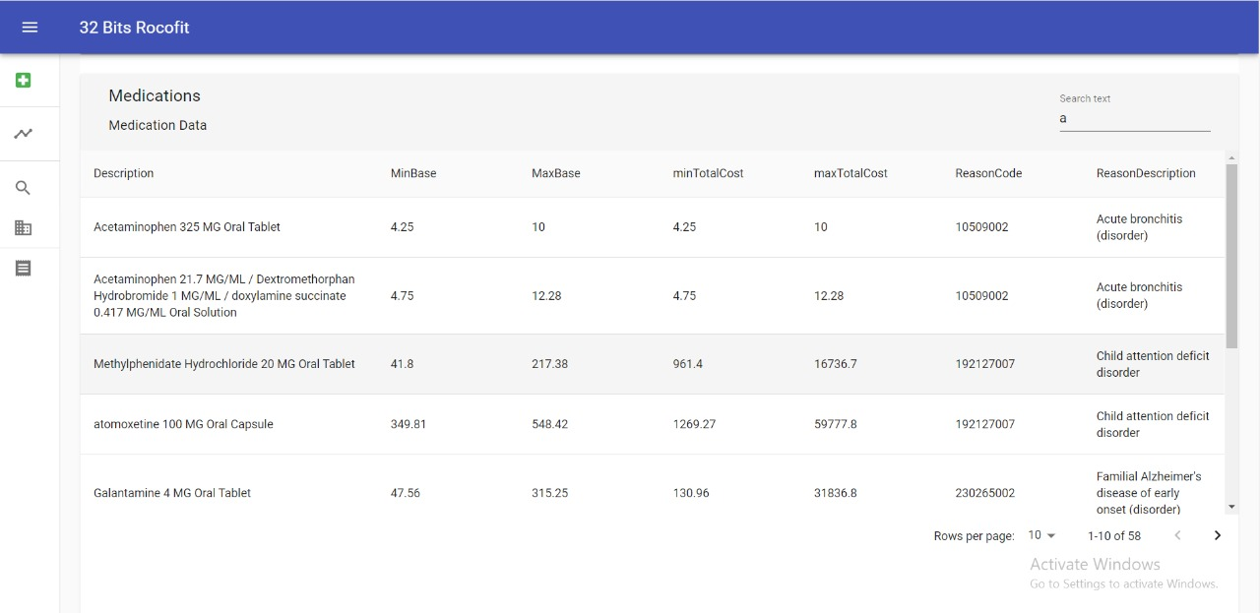

Slide 6
We help you to find the best hospitals
We show the best hospitals around based on location and the ailment patient want to treat
Every Hospitals have a rating based on the member’s(patient) review as well as from the fraud detection api
We provide a interface so that member can book an appointment.This interface shows the times that are available
Every data (location/price) are taken from the provided dataset.

Slide 7
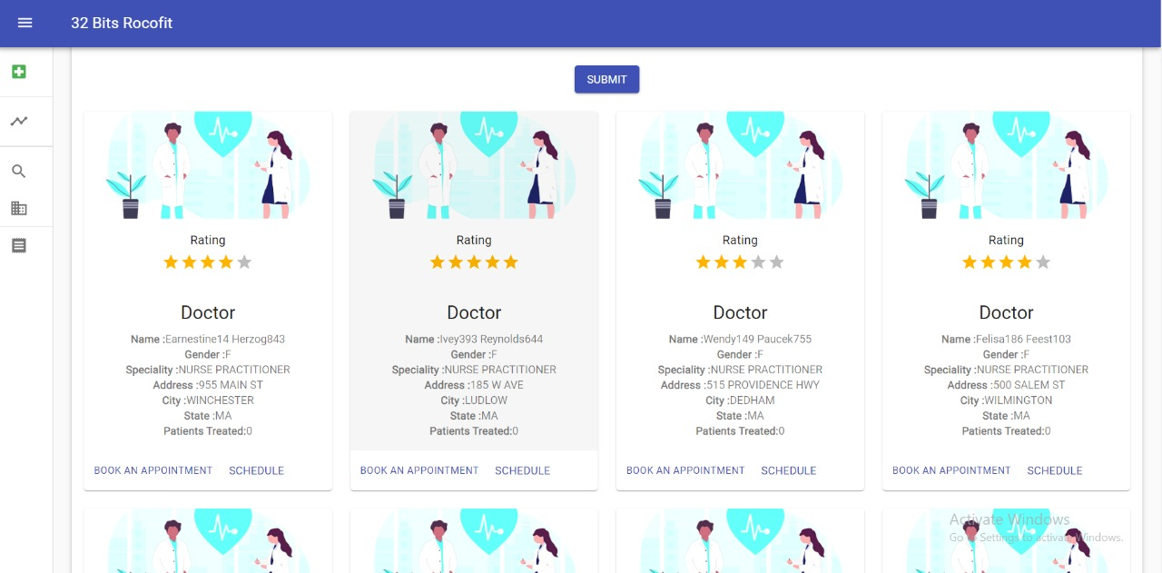
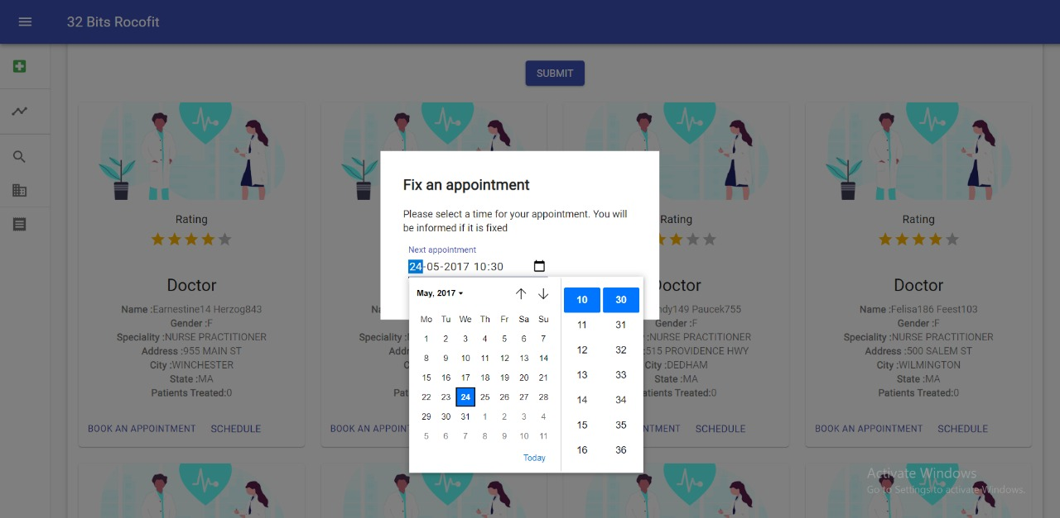

Slide 8
Realtime vitals monitor
We are tracking heart rate,steps and blood pressure of the user.
We use google fit API to stream the real time data.Anyone who have a smart device running android wear can register to our app with the same emails and we can stream their data.
We will be also running an realtime unsupervised anomaly detection on the user vitals.
The anomaly detection algorithm we are using is Extended Isolation Forest.
We will notify the user, and hospital if the user vitals show any anomaly

Slide 9
Health Score
We wanted to create a uniform score using which Insurance company(Optum) can construct a notion about the person’s health.So that they can predict in advance how much they may have to pay for him.Inturn the member(patient) can also look at the score and see why he/she may have a low score and can work on his/her health to maintain a good health score.To calculate the health score we are looking at 4 different kind of factors

Slide 10
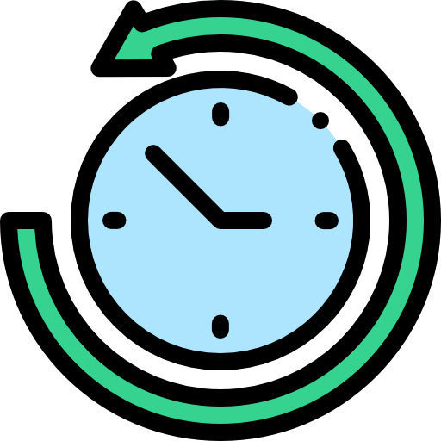
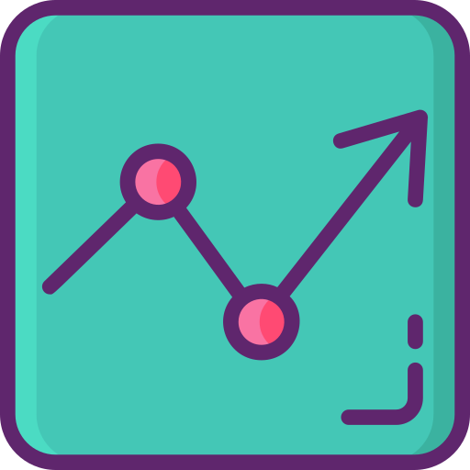
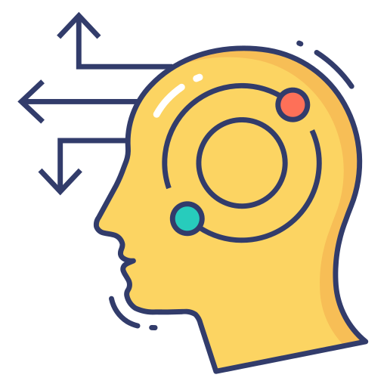
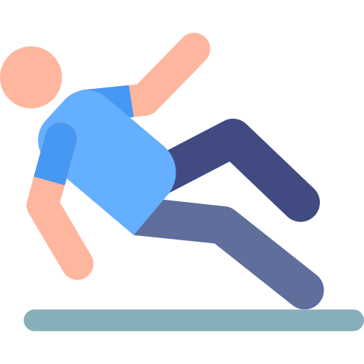
How we calculate Health score
We take a look at past information about a patient
We analyze realtime health stat and run a anamoly detection,We take a look at the frequency of these anamolies.
We use machine learning to predict about the health condition of the patient
We give different weights to relapses and new problems.We give more negetive feedback to relapses

Slide 11
Machine Learning model
For Predicting BMI of a person using his/her diet plans we employ a regression based model.We looked a number of papers on this topic and found one which uses NHANES dataset to do the same and achive state of the art accuracy.We used the same technique to and trained on the same dataset.For our use case we run the model taking inputs from the user and use it to predict future BMI scores.

Slide 12

Health score
Finally we combine all the dirrent factors to get the health score.
As we are using past ,present and predicted data we can say that the health score is a credible way to rate an user.

Slide 13
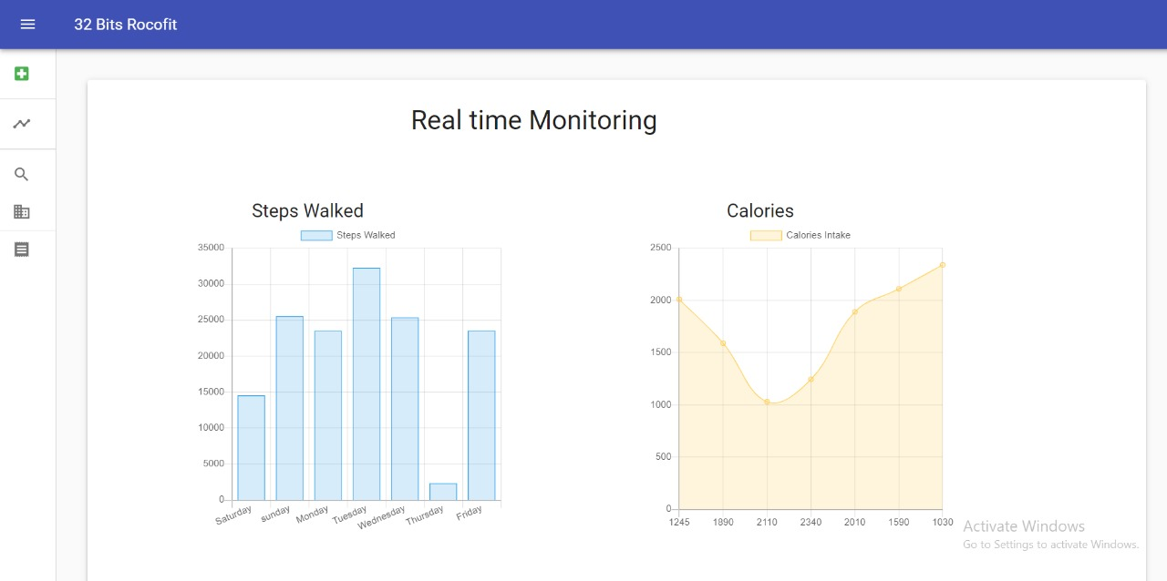
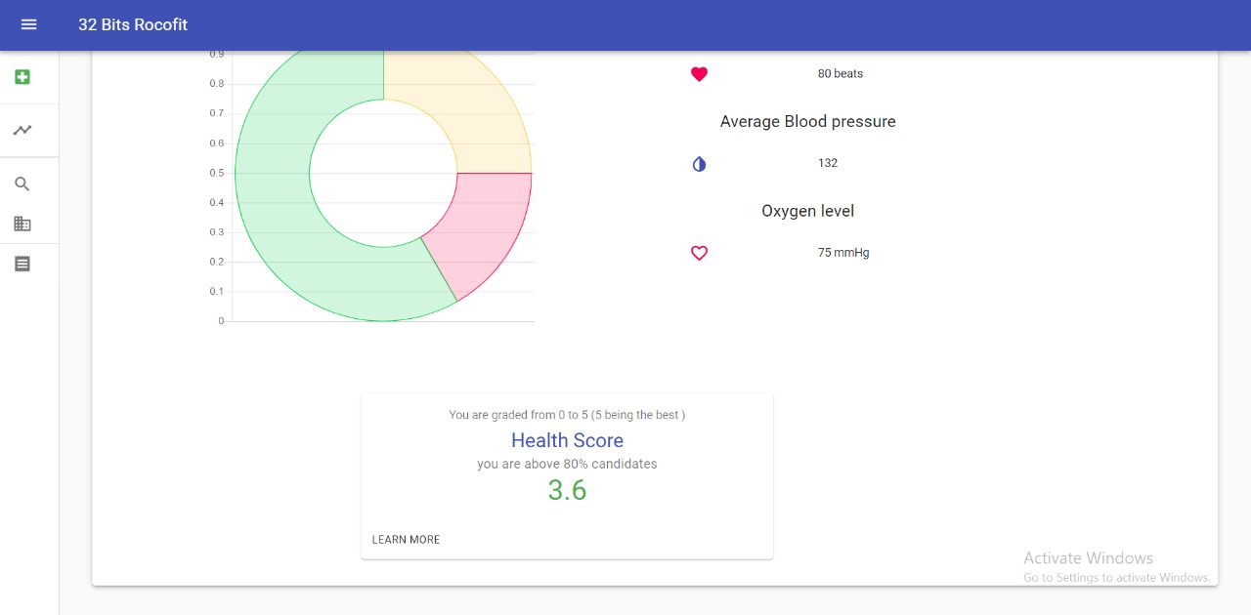

Slide 14
Tech stack
Tech stack
1)React.js
2)Flask
3)My SQL
4)Python
5)Scikit learn
1)React.js
2)Flask(python)
3)Scikit learn
4)Google fit API
5)SQL database
6)Pandas
7)NumPY

Slide 15
Citations
CITATIONS
1)Selya, Arielle & Anshutz, Drake. (2018). Machine Learning for the Classification of Obesity from Dietary and Physical Activity Patterns. 10.1007/978-3-319-77911-9_5.
1)Selya, Arielle & Anshutz, Drake. (2018). Machine Learning for the Classification of Obesity from Dietary and Physical Activity Patterns. 10.1007/978-3-319-77911-9_5.
2)Centers for Disease Control and Prevention (CDC). National Center for Health Statistics (NCHS). National Health and Nutrition Examination Survey Data. Hyattsville, MD: U.S. Department of Health and Human Services, Centers for Disease Control and Prevention,[2011,2013]

Slide 16
Team Name: 32_bits
Team Member 1: Avigyan Das, Jadavpur University,4th year
Team Member 2: Subhadeep Gupta, Jadavpur University,4th year
Team Member 3:Arnab Kundu, Jadavpur University,4th year
Mentor - Abhiroop Kumar abhiroop.kumar@optum.com;
Github link of the project: https://github.com/abhi1998das/optum2

